Slide 1


Artificial Intelligence Practical Sessions
Department of Mathematics and Computer Science
Universitat de Barcelona
Fall 2023-2024

Slide 2
Lab & Visiting hours
Ignasi Cos
Group F (Tuesdays 17-19, Classroom IB)
Visiting hours: Tuesdays from 15:00 to 16:00, ignasi.cos@ub.edu
Adrián Fernández Cid
Group A (Wednesdays 19:00-21:00, Classroom IB)
Visiting hours: Wednesdays from 11:00 to 12:00, adrian_fernandez@ub.edu
Polyxeni Gkontra
Group B (Tuesdays 19:00-21:00, Classroom IB)
Visiting hours: Tuesdays 18:00-19:00, polyxeni.gkontra@ub.edu
Please send us an email a day in advance to schedule an appointment if you plan to attend the designated visiting hours

Slide 3
Calendar
Date | Content
19-20/9 | P1: Introduction and problem definition
26-27/9 | A* search, heuristics
3-4/10 * | Delivery P1 **
10-11/10 | P2: minimax & Alpha-beta pruning
17-18/10 | Expectimax
24-25/10* | Delivery P2
31/10-1/11 | Practical session cancelled (Bank Holiday)
7-8/11 | Practical session cancelled (Partial Exams)
14-15/11 | P3: Markov Decision Processes (MDPs)
21-22/11 | Reinforcement Learning I (Q-Learning)
28-29/11 | Advanced Reinforcement Learning
5-6/12 | Practical session cancelled (Bank holiday)
12-13/12* | Delivery P3
19-20/12* | P4: Data Science session with delivery
Delivery involves submitting code (Python) and accompanying text via the virtual campus & attendance to the respective practical session
Practicals account for 40% of the final mark
IMPORTANT NOTES!
* Attendance on the submission date is mandatory. Failure to attend will result in a grade of 0 for the practical exercise.
** Submission of P1 for Group B is scheduled for 3/10 at 18.00-19.00 – Mark your calendar!

Slide 4
Problem definition (P1-P2-P3)
Chess problems to resolve using Artificial Intelligence algorithms
P1: Find shortest path to check-mate (A* search algorithm)
Simplified board setup with a white rook, white king, black king
Blacks cannot move
P2: Simulate a chess game, i.e. adversarial game where oponents take turns (minimax, alpha-beta pruning, expectimax)
Simplified set-up with white & black rooks, white & black kings
Both Blacks and Whites can move alternating turns
P3: Solving Problems via Reinforcement Learning

Slide 5

Material Overview
Assignment sheets
Code in Python for a chess simulator with four classes
Chess
Class representing the game of chess
Board
Class representing a chess board
Piece
Class representing a piece in chess
No need for modifications in this class
Aichess
Serves a capsule for the 3 classes to develop the exercises
AI algorithms should be implemented within the aichess class
You can download the material from the Campus Virtual

Slide 6
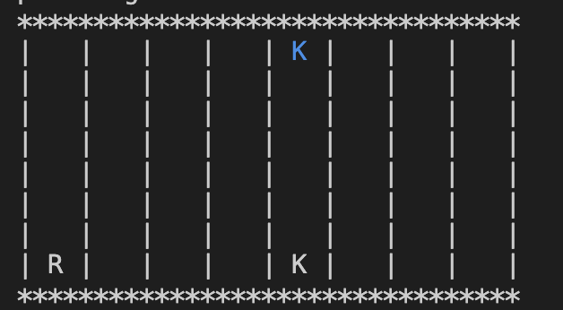
State of the chessboard
State: list of 3 elements [row, column, piece_type]
__init__ method of Board class contains piece correspondence and name list
E.g White Rook: 2, White King: 6, Black Rook: 8, Black King: 12
[0,4,12]
[7,0,2]
Board configuration for P1
[7,4,6]
Notes:
list of elements containing the positions and types of pieces you move

Slide 7
AIChess.py
Selected attributes of interest
CurrentState: The list of positions and pieces of the White pieces on the board
ListNextStates: The list of states of next potential states from the current state
ListVisitedStates: The list of already visited states in the tree
PathToTarget: The sequence – python list of states from the origin to the target state yielded by the search algorithm

Slide 8
AIChess.py
Selected functions of interest (1/2)
isCheckMate(self, mystate): Function to check whether the given state is a checkmate
For P2, a more advanced implementation may be needed to accurately identify checkmate scenarios.
canviarEstat(self, start, to): Function to simulate the movement of a single piece from the 'start' state to the 'to' state.
movePieces(self, start, depthStart, to, depthTo): Function to moves all pieces from the 'start' state to the 'to' state.

Slide 9
AIChess.py
Selected functions of interest (2/2)
reconstructPath(self, state, depth): Reconstructs the sequence of states that lead to a checkmate from the 'state' at a specific 'depth’.
It utilizes attribute pathToTarget to store the path.
Essential for visualizing and understanding the path to checkmate.
h(self, state): Heuristic function that estimates and returns the cost of reaching a checkmate from the 'state' using Manhattan distance.
AStarSearch(self, currentState) (Your Task!): Develop a function to perform A* search for finding a checkmate from the 'currentState'.

Slide 10
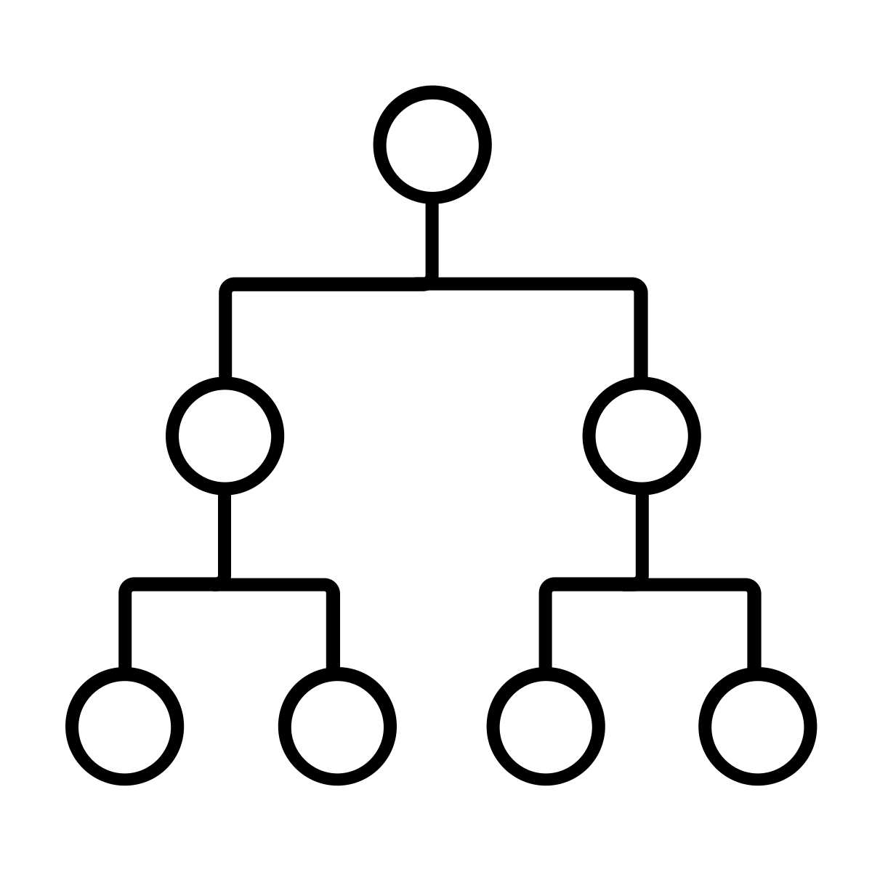
AIChess.py - Other functions
Note! You do not need to implement BFS & DFS
Example implementations
Breadth First Search algorithm (BreadthFirstSearch)
Depth First Search (DepthFirstSearchOptimized, DepthFirstSearch)
Auxiliary functions: worthExploring

Slide 11
Board.py
Selected functions of interest
isSameState(self, a, b): Function to check whether two states of the board are the same
getListNextStatesW(self, mypieces): Function to get the list of next possible states
Watch out! To get the list of next states you have first to move the pieces in the board
print_board(self): Print the current board

Slide 12
Chess.py
Selected attributes of interest (instances of board.Board class)
board: Represents the current state of the chessboard
Use this board to make movements for which you are certain
boardSim: Represents a simulation of the chessboard
Use this board to simulate movements to decide the best strategy

Slide 13
Chess.py
Selected functions of interest
move(self, start, to, verbose=False): Function to move a piece from one “start” position to “to” position
Currently, the code does not truly eliminate pieces when a move is made (P2 requirement)
To kill pieces you will need to eliminate taken pieces from current state of board & boardSim by updating this function
When blacks will be able to move, the current state for blacks should also be updated (similarly to currentStateW, currentStateB).
moveSim(self, start, to, verbose=True): Function to simulate a move of the piece at `start` to `to` without making the actual move on the board
All print statements are commented out; you can uncomment and use the verbose argument for debugging or insights.

Slide 14

P4. Data Science Session
Prediction of heart disease using supervised machine learning (ML)
Binary classification problem
Develop a pipeline to train and test a classifier using given medical data
Input: Features related to health condition (categorical & numerical)
Output: Diseased versus healthy
Familiarity with pandas will be helpful

Slide 15
Questions?

